Slide 1
Microcomputer and System Bus

Slide 2
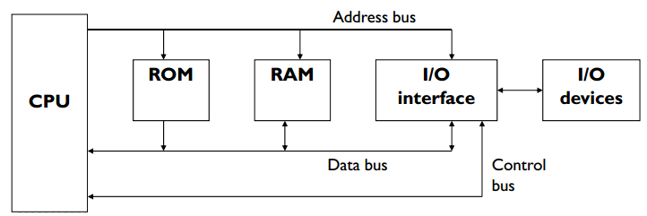
Block Diagram of a Simple Microcomputer:

Slide 3
Microcomputer Structure
DATA BUS
INPUT
CONTROL BUS
CONTROL BUS
I/O PORTS
MEMORY( RAM AND ROM)
CPU
OUTPUT
ADDRESS BUS

Slide 4
Block Diagram of a Simple Microcomputer:
Components of Microcomputer:
CPU
Memory
Input / Output circuitry
System Buses:
Address bus
Data bus
Control bus

Slide 5
Microcomputer Structure
A Microcomputer system is one which uses a microprocessor as its CPU.
In addition the Microcomputer also has a memory unit, input/output devices and system buses.
It consists - Address Bus, Data Bus, Control Bus
What is a Bus?
A group of lines used to transfer bits between microprocessor and other system components like memory and I/O devices.

Slide 6
CPU - Central Processing Unit
It controls the operation of computer
The CPU fetches binary-coded instructions from memory
Decodes the instructions into a series of simple actions
Carries out these actions in a sequence of steps
Important components: IP (Instruction Pointer), General purpose registers and Control bus signal generating circuits

Slide 7
CPU
Fetches the binary-coded instructions from memory, decodes the instructions into a series of actions and carries out these actions in a sequence of steps.
Contains an address register to hold the address of next instruction to be fetched from memory.
General purpose registers to store binary data temporarily, and circuitry to generate the control bus signal.

Slide 8
Memory
It usually consists of a mixture of RAM and ROM. It may also have hard disks or optical disks.
Two purposes:
Store the binary codes of instructions
Store the binary coded data

Slide 9
Memory:
It stores the binary codes for the sequence of instructions and binary coded data. Example: ROM, RAM and Magnetic disks
RAM can be read and written to anytime the CPU commands it, but ROM is pre-loaded with data and software that never changes, so the CPU can only read from it.
ROM is typically used to store the computer's initial start-up instructions.
In general, the contents of RAM are erased when the power to the computer is turned off, but ROM retains its data indefinitely.
In a PC, the ROM contains a specialized program called the BIOS that orchestrates loading the computer's operating system from the hard disk drive into RAM whenever the computer is turned on or reset.

Slide 10
System Bus:
The microcomputer’s system bus contains three buses: address, data, and control bus
When a memory or an I/O chip receives data from the microprocessor, it is called a WRITE operation, and data is written into a selected memory location or an I/O port (register).
When a memory or an I/O chip sends data to the microprocessor, it is called a READ operation, and data is read from a selected memory location or an I/O port.

Slide 11
Address bus
Consists of 16, 20, 24, 32, or 36 parallel signal lines. Therefore it is that bit long.
The number of locations that the CPU can address is determined by the number of address lines.
On these lines the CPU sends out the address of the memory location.
If the CPU has N address lines then it can directly address 2^{N} memory locations.

Slide 12
Address Bus:
It is a Unidirectional bus.
Information transfer takes place from the MP to the memory or I/O elements.
On these lines the CPU sends out the address of the memory location or I/O port that is to be written to or read from.
For example : microprocessor with 32 address pins can generate
2³²= 4,294,964,296 bytes
Example : if address line 16 then 2¹⁶ memory locations

Slide 13
Control Bus:
It consists of a number of signals that are used to synchronize operation of the individual microcomputer elements.
Consists of potentially many signals. Typically:-
Read
Write
Interrupt control
Bus control signals for DMA (Direct Memory Access)

Slide 14
Control bus
4 to 10 parallel signal lines
CPU sends signal on the control bus to enable the outputs of addressed memory devices.
Memory Read, Memory Write, I/O Read, I/O Write.
To read a byte of data the CPU sends out the memory address of the desired byte on the address bus and sends out Memory Read signal.

Slide 15
Data Bus:
It is a bidirectional bus, i.e. CPU can read or send data both
Data can flow in both directions, that is, to or from the microprocessor.
The size of the data bus varies from one microprocessor to another.
Usually matches the word length of the microprocessor
Usually a multiple of 8
We talk of 4-bit (nibble), 8-bit, 16-bit , 32-bit and 64-bit processors which refers to the normal word length of the microprocessor.

Slide 16
Input/Output
Allows the computer to take in data from the outside world or send data to the outside world.
Keyboards, monitor, printer are connected to I/O section.

Slide 17
I/O Unit:
Input/output (I/O), refers to the communication between an information processing system (such as a computer), and the outside world possibly a human, or another information processing system.
Inputs are the signals or data received by the system, and outputs are the signals or data sent from it.
Devices that provide input or output to the computer are called peripherals like the keyboard and mouse, and output devices such as the display and printer, hard disk drives and optical disc drives serve as both input and output devices.
Computer networking is another form of I/O.

Slide 18
Fetching & Execution Cycles:
Fetching Cycles
The fetch cycle takes the instruction required from memory, stores it in the instruction register, and
Moves the program counter by one so that it points to the next instruction.
Execute cycle
The actual actions which occur during the execute cycle of an instruction.
Depends on both the instruction itself and the addressing mode specified to be used to access the data that may be required.

Slide 19
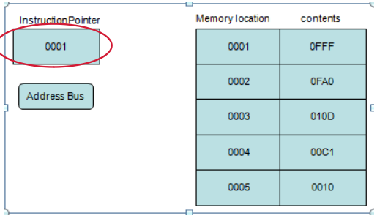
Fetching & Execution Cycles:
Step 1
Instruction Pointer (IP) or a program counter is a register, that holds the address of the next instruction to be fetched.

Slide 20
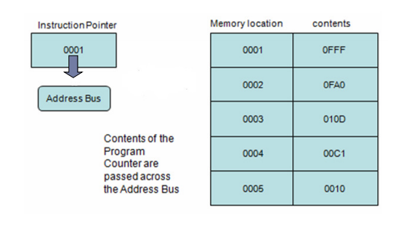
Fetching & Execution Cycles:
Step 2

Slide 21
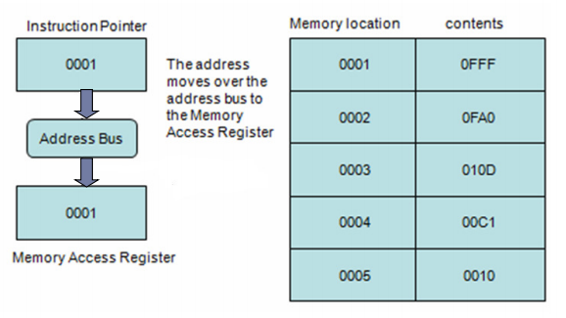
Fetching & Execution Cycles:
Step 3

Slide 22
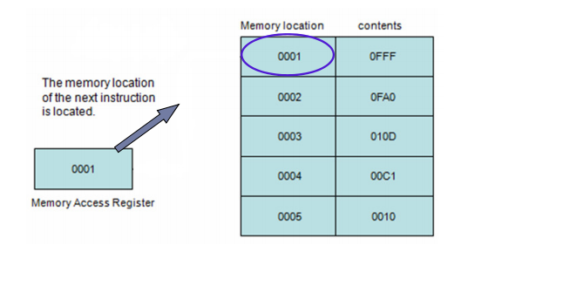
Fetching & Execution Cycles:
Step 4

Slide 23
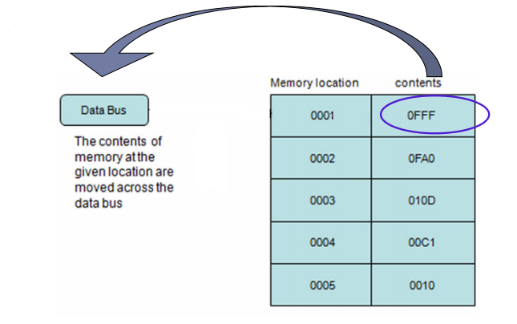
Fetching & Execution Cycles:
Step 5

Slide 24
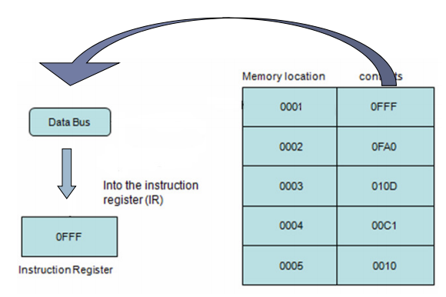
Fetching & Execution Cycles:
Step 6

Slide 25
Simple Microcomputer - All Bus Operation
A microcomputer fetches each program instruction in sequence, decodes the instruction and executes it.
The CPU in a microcomputer reads data from memory by sending out an address on the address bus and a Memory Read signal on the control bus. The memory output the addressed instruction or data word to the CPU on the data bus.
The CPU writes a data word to memory by sending out an address on the address bus, sending out the data word on the data bus and sends a Memory Write signal to memory on the control bus.
To read data from a port the CPU sends out the port address on the address bus and send an I/O Read signal to the port device on the control bus. Data from the port comes into the CPU on the data bus.
To write data to a port the CPU sends out the port address on the address bus, sends out the data to be written to the port on the data bus, and sends an I/O Write signal to the port device on the control bus.

